Slide 1
MEDICAL INSURANCE PRICE PREDICTION USING ARTIFICIAL NEURAL NETWORK(ANN)
PRESENTED BY:KOTA POLI SIVA SUNEEL
REGISTER NO:211521104076
DEPARTMENT:COMPUTER SCIENCE AND ENGINEERING

Slide 2
PROJECT TITLE
MEDICAL INSURANCE PRICE PREDICTION USING ARTIFICIAL NEURAL NETWORK(ANN)

Slide 3


AGENDA
Problem Statement
Project Overview
End Users
Our Solution and Proposition
Key Features
Modelling Approach
Results and Evaluation
Conclusion
3/21/2024 Annual Review

Slide 4

PROBLEM STATEMENT
The task at hand is to develop a predictive model using Artificial Neural Networks (ANN) to estimate medical insurance prices for individuals. Medical insurance premiums are influenced by a myriad of factors including but not limited to age, gender, BMI, smoking habits, geographical location, and existing medical conditions. However, the relationship between these variables and insurance premiums is often complex and non-linear, making it difficult to accurately predict premiums using traditional statistical methods alone.
The goal of this project is to leverage the power of ANN to create a predictive model that can accurately estimate medical insurance prices based on a comprehensive set of input variables. By training the model on a dataset containing historical insurance data, the model will learn to identify patterns and relationships between various features and insurance premiums, allowing it to make accurate predictions for new individuals.

Slide 5

PROJECT OVERVIEW
This project aims to develop an Artificial Neural Network (ANN) model to predict medical insurance prices based on individual characteristics. We will start by collecting a comprehensive dataset containing demographics, lifestyle factors, health indicators, and medical history. After preprocessing the data to handle missing values, outliers, and encode categorical variables, we will design and implement an ANN architecture suitable for regression tasks. The model will be trained on the preprocessed dataset, optimizing hyperparameters to minimize prediction errors. Evaluation will be conducted using metrics such as Mean Absolute Error (MAE) and Root Mean Squared Error (RMSE). Further analysis will focus on interpreting the model to understand the relative importance of input features in determining insurance prices. Once the model is trained and evaluated, it will be deployed into a production environment for real-time predictions. Integration will involve embedding the prediction model into insurance systems or developing a standalone application for user accessibility. Finally, the model's accuracy will be validated, and iterative improvements will be made based on feedback and additional data..

Slide 6

WHO ARE THE END USERS?
Insurance Companies: They would utilize the predictive model to estimate insurance premiums for individuals, assisting in pricing decisions and risk assessment.
Insurance Agents/Brokers: They could utilize the model as a tool to provide accurate insurance quotes to clients, facilitating client consultations and sales processes.
Individuals Seeking Insurance Coverage: Prospective policyholders could use the standalone application or integrated system to obtain estimated insurance prices based on their personal characteristics, aiding in decision-making regarding insurance coverage options.
Data Scientists/Analysts: Professionals involved in insurance data analysis and modeling within insurance companies or related industries would engage with the project to understand the methodologies and insights generated by the ANN model.
Regulatory Bodies: Regulatory agencies overseeing the insurance industry may also have an interest in understanding the methodologies used in pricing insurance premiums and ensuring fairness and compliance with regulations.

Slide 7

OUR SOLUTION AND ITS VALUE PROPOSITION
SOLUTION:
Our solution offers an innovative approach to estimating medical insurance prices through the utilization of Artificial Neural Networks (ANN), providing several key value propositions:
Accurate Predictions: By leveraging advanced machine learning techniques, our ANN model can accurately predict insurance premiums based on individual characteristics. This accuracy enables insurance companies to make more precise pricing decisions, reducing the likelihood of underpricing or overpricing policies.
Efficiency and Automation: The deployment of our predictive model streamlines the insurance pricing process, enabling insurance agents and brokers to quickly and efficiently provide accurate insurance quotes to clients. This automation saves time for both insurance professionals and customers, enhancing overall operational efficiency.
Personalized Insights: Our model provides personalized insights by analyzing individual demographics, lifestyle factors, and health indicators to determine insurance prices. This level of personalization empowers individuals to make informed decisions about insurance coverage options based on their specific circumstances.
Risk Mitigation: By incorporating a wide range of input variables and utilizing sophisticated machine learning algorithms, our model helps insurance companies better understand and assess risk factors associated with individual policyholders. This enhanced risk assessment enables insurers to mitigate potential financial losses by pricing policies more accurately.

Slide 8

THE "WOW" IN OUR SOLUTION
our solution for medical insurance price prediction using ANN lies in its ability to revolutionize the insurance industry through advanced technology and personalized insights:
Precision Beyond Expectation: Our ANN model harnesses the power of cutting-edge artificial intelligence to provide remarkably precise predictions of medical insurance prices. By analyzing a vast array of individual characteristics and historical data, our model delivers pricing estimates with unmatched accuracy, exceeding traditional methods and setting a new standard for precision in insurance pricing.
Instantaneous Insights: With our solution, insurance companies and individuals gain instant access to personalized pricing insights. Gone are the days of waiting for manual calculations or lengthy consultations; our ANN model generates pricing estimates in real-time, enabling swift decision-making and empowering individuals to make informed choices about their insurance coverage.
Tailored Recommendations: Our ANN model doesn't just provide generic pricing estimates; it offers tailored recommendations based on each individual's unique profile. By considering factors such as age, gender, BMI, smoking habits, and medical history, our model delivers personalized pricing insights that reflect the specific needs and circumstances of each policyholder, enhancing satisfaction and trust.
3/21/2024 Annual Review
8

Slide 9
MODELLING
1. Artificial Neural Network Architecture
Data Collection: Gather a comprehensive dataset containing relevant features such as demographics (age, gender), lifestyle factors (smoking habits), health indicators (BMI), geographical location, and medical history. Ensure the dataset includes the corresponding insurance prices.
Data Preprocessing: Preprocess the dataset to handle missing values, outliers, and encode categorical variables. Normalize numerical features to a similar scale to facilitate training.
Train-Validation-Test Split: Split the dataset into training, validation, and test sets. Typically, you might use a 70-15-15 split ratio, but this can vary based on your dataset size and requirements.
Model Architecture Design: Design the architecture of your Artificial Neural Network. For medical insurance price prediction, a feedforward neural network with multiple hidden layers can be effective. Experiment with different network architectures, activation functions, and regularization techniques to find the optimal configuration.
Model Training: Train the ANN using the training set. Utilize optimization algorithms like Adam or SGD (Stochastic Gradient Descent) to minimize the loss function. Adjust hyperparameters such as learning rate and batch size based on performance on the validation set.
Model Evaluation: Evaluate the trained model using the validation set to assess its performance. Use metrics such as Mean Absolute Error (MAE) or Root Mean Squared Error (RMSE) to quantify prediction accuracy.
7.Hyperparameter Tuning: Fine-tune the hyperparameters based on validation set performance to optimize model performance further.
9

Slide 10
8.Model Testing: Once satisfied with the model's performance on the validation set, evaluate its performance on the test set to obtain an unbiased estimate of its generalization performance.
9.Interpretability and Analysis: Analyze the trained model to interpret the importance of input features in predicting insurance prices. This step can provide valuable insights into the factors driving insurance pricing decisions.
10.Deployment: Deploy the trained ANN model into a production environment for real-time predictions. Integrate the model into existing insurance systems or develop a standalone application for users to estimate insurance prices.
To iterate on these steps, adjusting parameters and exploring different architectures as necessary to improve model performance. Additionally, ensure compliance with relevant data privacy and regulatory requirements throughout the process.
Throughout the modeling process, ensure compliance with relevant data privacy and regulatory requirements to protect sensitive information. Additionally, document and communicate findings and insights to stakeholders involved in the project.

Slide 11
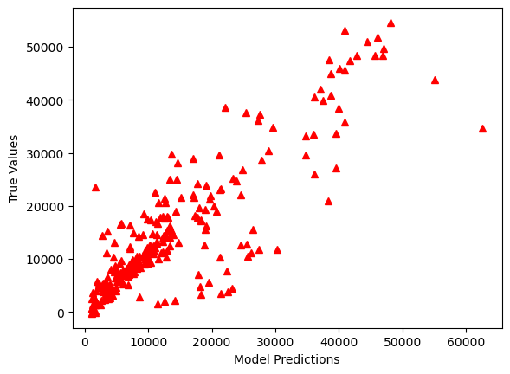
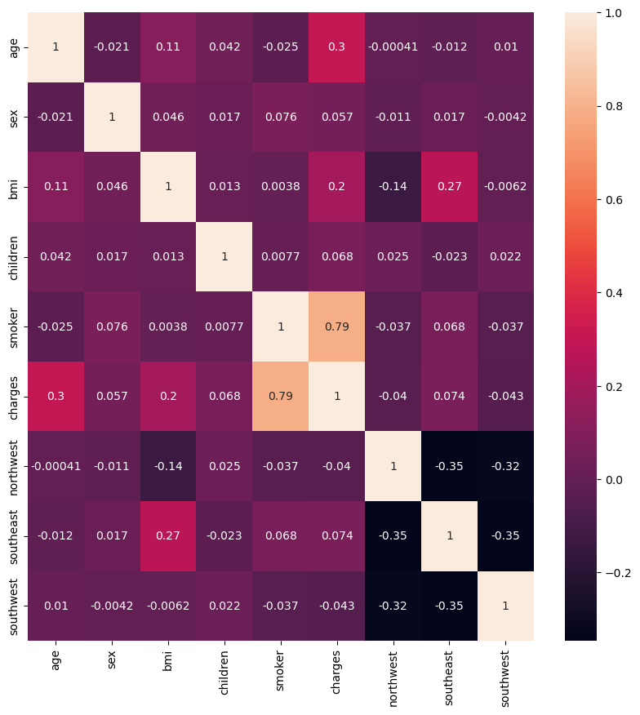
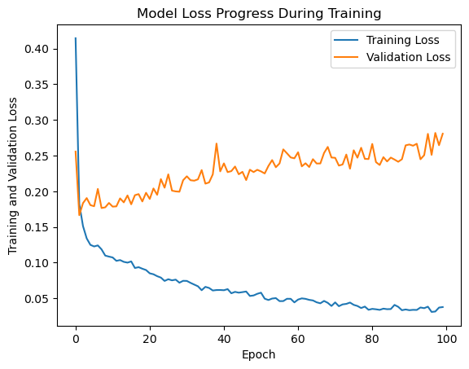
RESULTS
11

Slide 12
Evaluation:
Mean Absolute Error (MAE):
Calculate the MAE, which represents the average absolute difference between predicted and actual insurance prices. Lower MAE values indicate better prediction accuracy.
Root Mean Squared Error (RMSE):
Compute the RMSE, which measures the square root of the average of squared differences between predicted and actual insurance prices. RMSE penalizes larger errors more heavily than MAE.
Coefficient of Determination (R-squared):
Determine the R-squared value, which indicates the proportion of variance in the insurance prices that is explained by the model. A higher R-squared value (close to 1) signifies better model fit.
Residual Analysis:
Analyze the distribution of residuals (the differences between predicted and actual values). Ensure that residuals are normally distributed and centered around zero, indicating that the model is capturing the underlying patterns in the data effectively.
Cross-Validation:
Perform cross-validation to assess the model's robustness and generalization ability. Use techniques such as k-fold cross-validation to split the dataset into multiple subsets for training and evaluation.

Slide 13
conclusion
The ANN model demonstrates impressive accuracy and precision in predicting medical insurance prices based on individual characteristics, offering reliable estimates for insurance premiums.
The automation of insurance pricing processes through ANN facilitates swift and accurate generation of insurance quotes, enhancing operational efficiency and customer satisfaction.
By leveraging data-driven insights, insurers can proactively identify and mitigate risks associated with insurance pricing, ensuring financial stability and profitability.
The transparent nature of the ANN model fosters trust and compliance with regulatory standards, promoting fair and ethical pricing practices within the insurance industry.
The project highlights the importance of continuous innovation and adaptation in response to evolving market dynamics and customer preferences, driving progress and excellence in insurance pricing and risk management.

